Slide 1
COMMUNITY SERVICE PROJECT Under the supervision of Mr.S.Ashok
BOTCHA SHARMILA
21VV1A0512
Department of Computer Science Engineering

Slide 2
CONTEXT
INTRODUCTION
PROJECT OVERVIEW
COMUNNITY SERVICE PART
PRERANA MITRA
WEEKLY REPORT

Slide 3
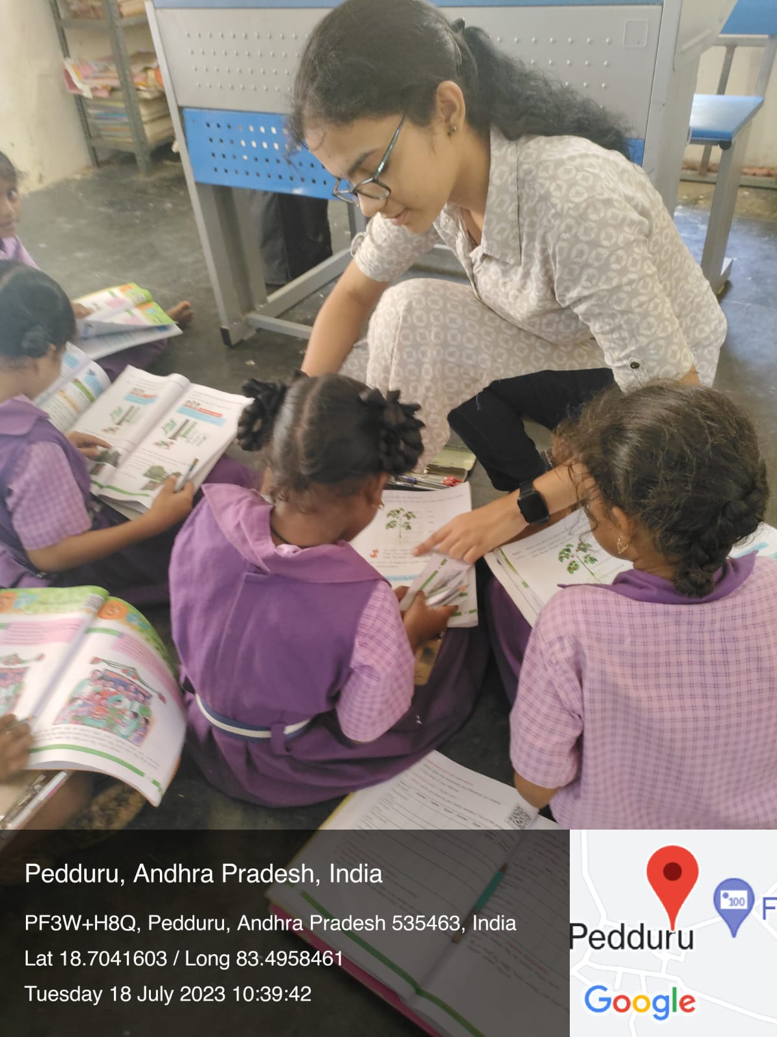
INTRODUCTION
I have done community service project at MPP School pedduru

Slide 4
PROJECT OVERVIEW
IMPORTANCE POF TELUGU
BASIC MATHEMATICS
BASIC COMPUTER
TECHNOLOGY
DISASTER MANAGEMENT AND PLANTATION
CAREER GUIDANCE
GENDER INEQUALITY

Slide 5
COMMUNITY SERVICE PART
Content 1: Importance Of Telugu And English
• Importance of learning Subject in MotherTongue and The
Importance of englishin current world.
Content 2: Basics Of Mathematics
• Explained easy way to solve simple
mathematics.
Content 3: Basics of Computer
• Discussion on how to operate Computer and the history of
computer and its uses.
Content 4: Technology
• Disscussion on the emerging technologies Cons and pros o
technology.

Slide 6
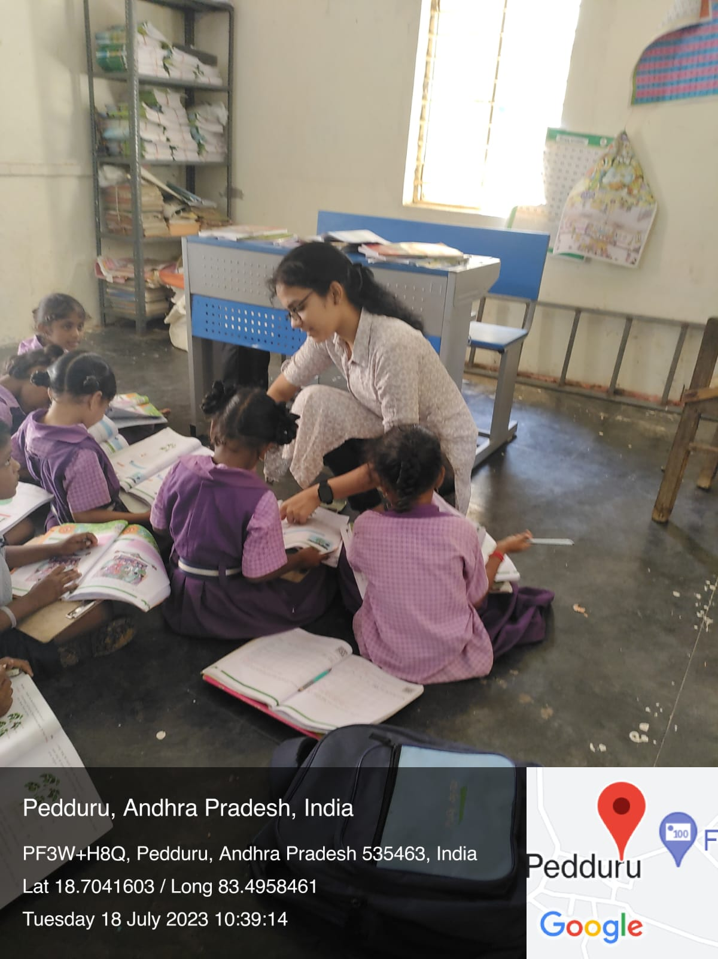
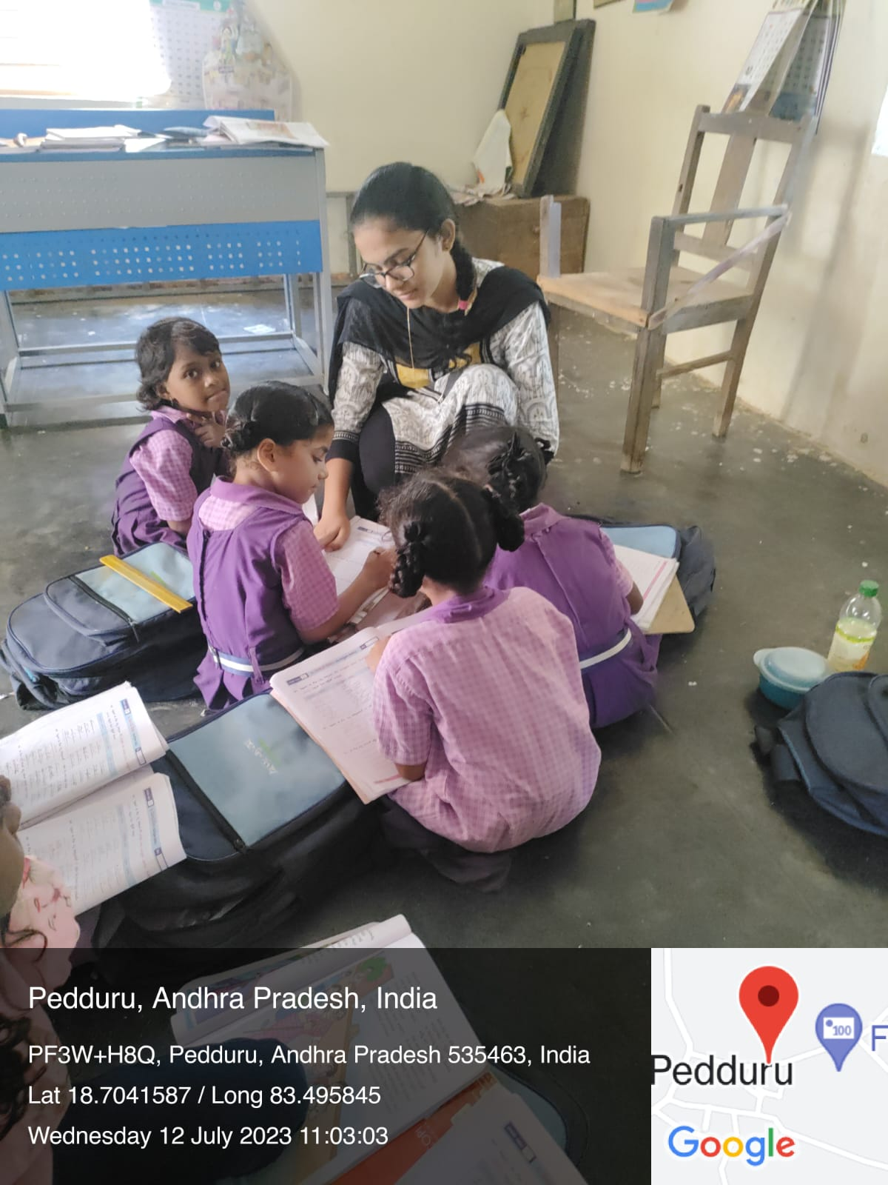

Slide 7
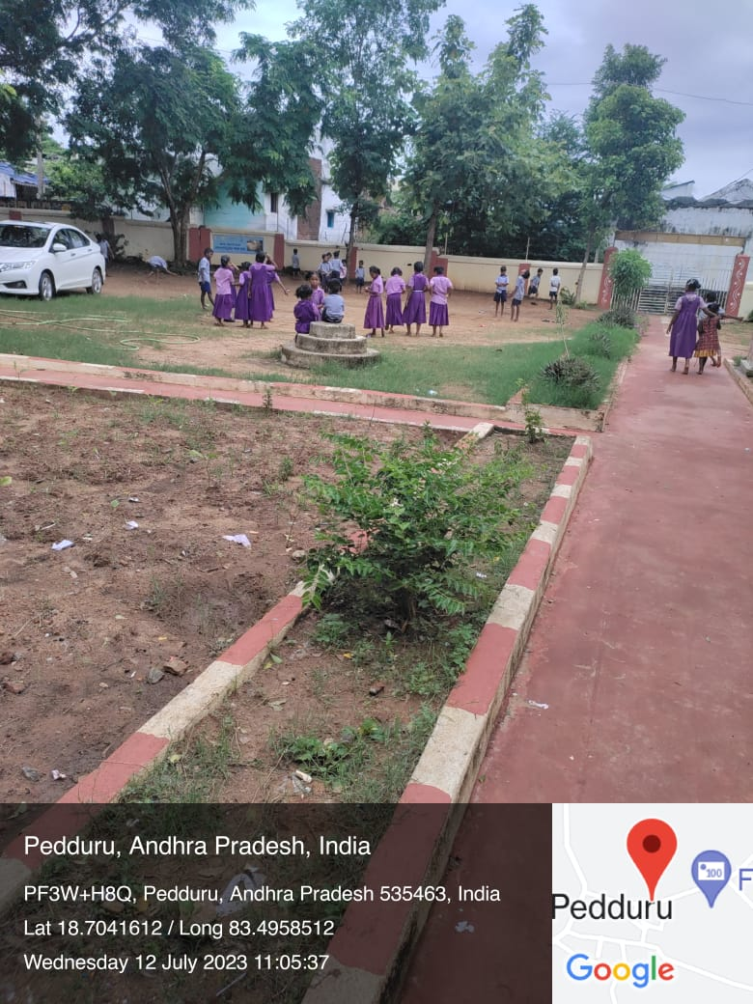
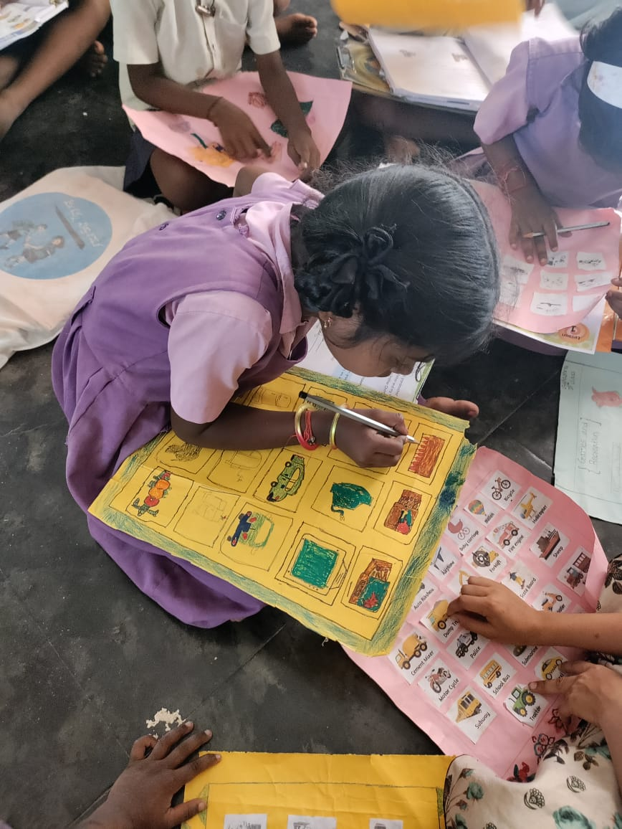
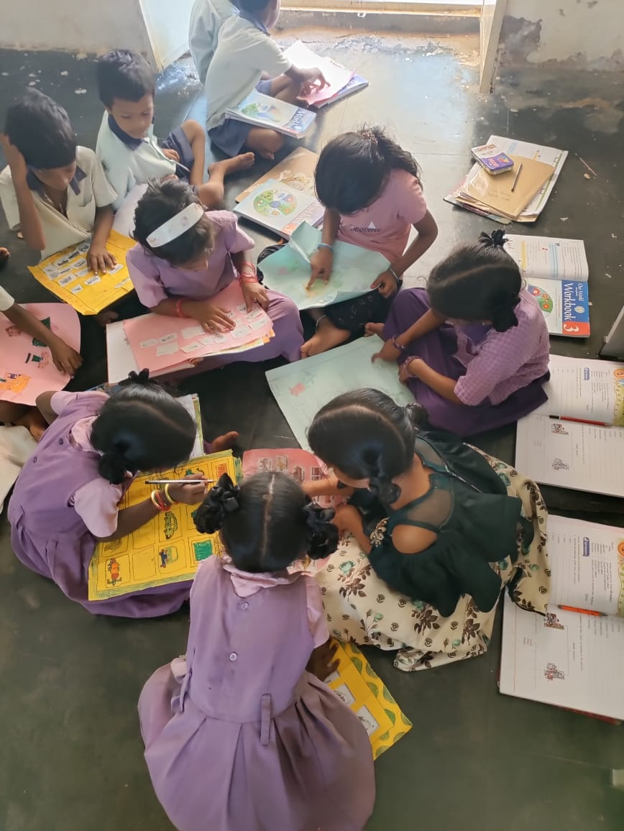
MPP SCHOOL PEDDURU

Slide 8
Content 5: Disaster Management And Plantation • Discussion on importance of their role in Disaster Mangement and plantation tosave our planet Content 6: Careeer Guidance • Disccusion about different Streams after 10th and Paths they have to take to achieve their dream jobs. Content 7:Gender Inequality • Discussion on Gender Inequality in society and their role to achieve gender equality
​

Slide 9

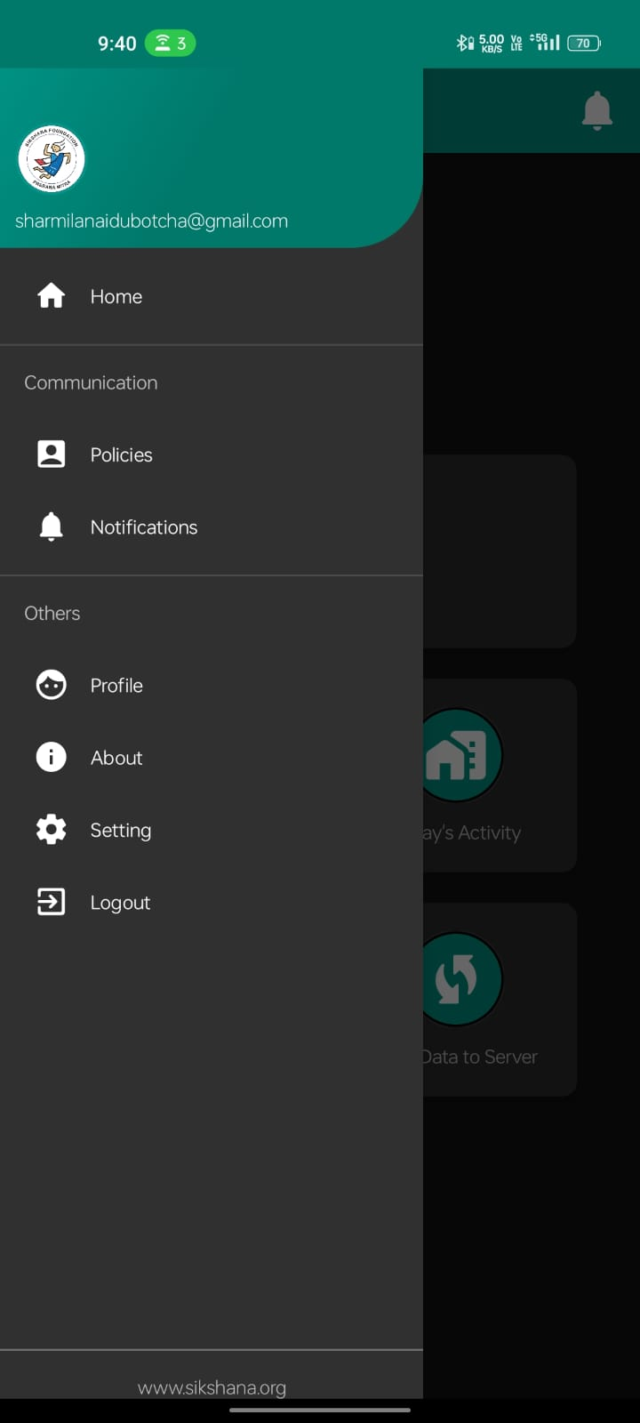
PRERANAMITRA
The ”Prerana Mitra” app stands as a
remarkable initiative by the Andhra
Pradesh government, aimed at
fostering meaningful community
engagement while harnessing the
capabilities of B.Tech students
pursuing their education in the state.

Slide 10
WEEKLY REPORT

Slide 11
areas of focus
B2B MARKET SCENARIOS
Develop winning strategies to keep ahead of the competition
Capitalize on low-hanging fruit to identify a ballpark value
Visualize customer directed convergence​
CLOUD-BASED OPPORTUNITIES
Iterative approaches to corporate strategy
Establish a management framework from the inside

Slide 12
how we get there
ROI
NICHE MARKETS
SUPPLY CHAINS
Envision multimedia-based expertise and cross-media growth strategies
Visualize quality intellectual capital
Engage worldwide methodologies with web-enabled technologies
Pursue scalable customer service through sustainable strategies
Engage top-line web services with cutting-edge deliverables
Cultivate one-to-one customer service with robust ideas
Maximize timely deliverables for real-time schemas

Slide 13

summary
At Contoso, we believe in giving 110%. By using our next-generation data architecture, we help organizations virtually manage agile workflows. We thrive because of our market knowledge and great team behind our product. As our CEO says, "Efficiencies will come from proactively transforming how we do business."​

Slide 14
thank you
mirjam nilsson
mirjam@contoso.com
www.contoso.com

